Slide 1
Algorithm Analysis
University of Technology and Engineering
Vietnam National University Hanoi

Slide 2
Algorithm analysis
A problem can be solved by different algorithms
Measure of “goodness”:
Running time
Memory
Traffic network

Slide 3
Running time
The running time of an algorithm typically grows with different factors:
Input data
Computer capacity
Programming languages/techniques
Compilers/Operating systems
etc.
Focus: input data versus running time

Slide 4
Running time
Depend on size of input data
Find a student from a list of n students
Sort a list of n numbers increasingly
Travel saleman problem with n cities
Depend on particular data sets

Slide 5
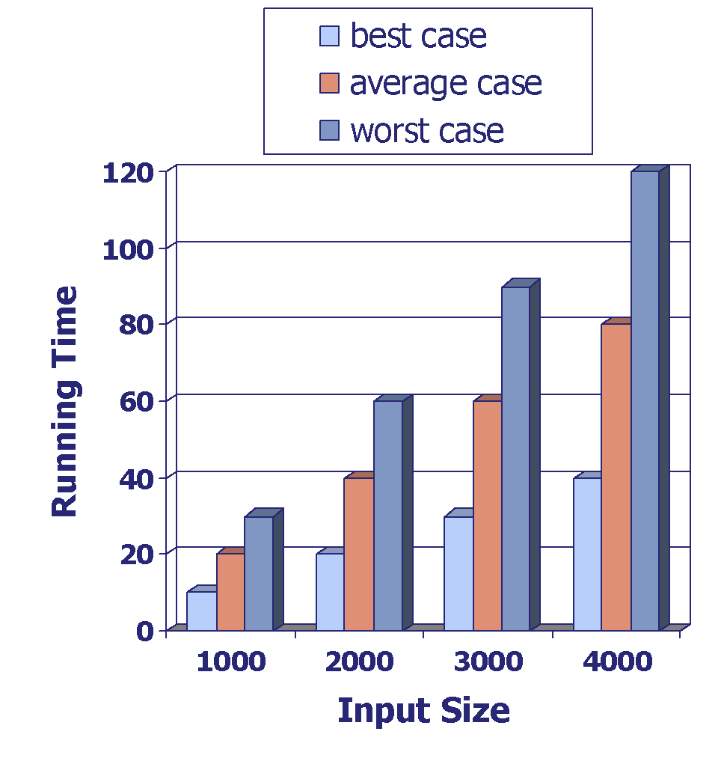
Time complexity
Worse-case run time
Average run time
Best-case run time
Notes:
Average case time is often difficult to determine
We focus on the worst case running time
Easier to analyze
Crucial to applications such as games, finance and robotics

Slide 6
Experimental analysis
It is necessary to implement algorithms, which may be difficult and time consuming
Results may not be indicative of the running time on other inputs not included in the experiment
In order to compare two algorithms, the same hardware and software environments must be used.

Slide 7
Theoretical Analysis
Ideally: characterizes running time as a function of the input size
Uses a high-level description of the algorithm instead of an implementation
Takes into account all possible inputs
Allows us to evaluate the speed of algorithms independent of the hardware/software environment.

Slide 8
Pseudo code
Mix of natural language and programming constructs: human reader oriented
High-level description of an algorithm
Less detailed than a program
Preferred notation for describing algorithms
Hides program design issues.
Algorithm arrayMax(A, n)
Input array A of n integers
Output maximum element of A
currentMax ← A[0];
for i ← 1 to n − 1 do
if A[i] • currentMax then
currentMax ← A[i];
return currentMax;
Example: find maximum element of A

Slide 9
Primitive Operations
Basic operations performed by an algorithm
Example: +, -, *, /, <, >
Largely independent from the programming language
Assumed to take a constant amount of time in the RAM model

Slide 10
Run time complexity analysis
Determine the maximum number of primitive operations as a function of the input size.
T(n) = the number of primitive operations
Example: T(n) = n + 1
Algorithm arraySum(A, n)
Input array A of n integers
Output sum of elements of A
sum ← 0;
for i ← 0 to n − 1 do
sum ← sum + A[i];
return sum;

Slide 11
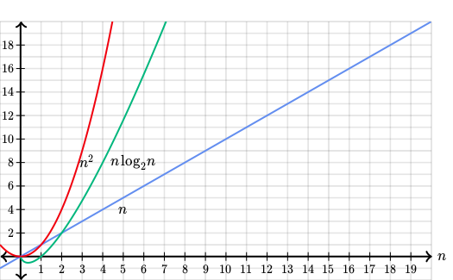
Run time complexity analysis
Analyze the shape of function T(n) .

Slide 12
Exercise 1
Count the number of of primitive operations
of the Count function:
Count (int n):
sum = 0
for (int num = 0; num < n; num++)
sum = sum + num
return sum

Slide 13
Exercise 2
Count the number of of primitive operations
of the Multiple function:
Multiple (int num_rows, num_cols, Matrix A):
product = 0
for (int row = 0; row < num_rows; row +)
for (col = 0; col < num_cols; col ++)
product = (sum * A[row][col]) mod 1000
return product

Slide 14
Run time complexity analysis
The run time complexity of two algorithms to solve the same problem:
Algorithm 1: T1(n) = f(n) = n + 100
Algorithm 2: T2(n) = g(n) = n² + 10
g(n)
time
f(n)
n₀
input size
Analyses:
The run time complexity of Algorithm 1 increases linearly with the input size
The run time complexity of Algorithm 2 increases quadratic with the input size
Algorithm 1 is better than algorithm 2 when n is greater than 10
Ignore constants from the run time complexity analysis.

Slide 15
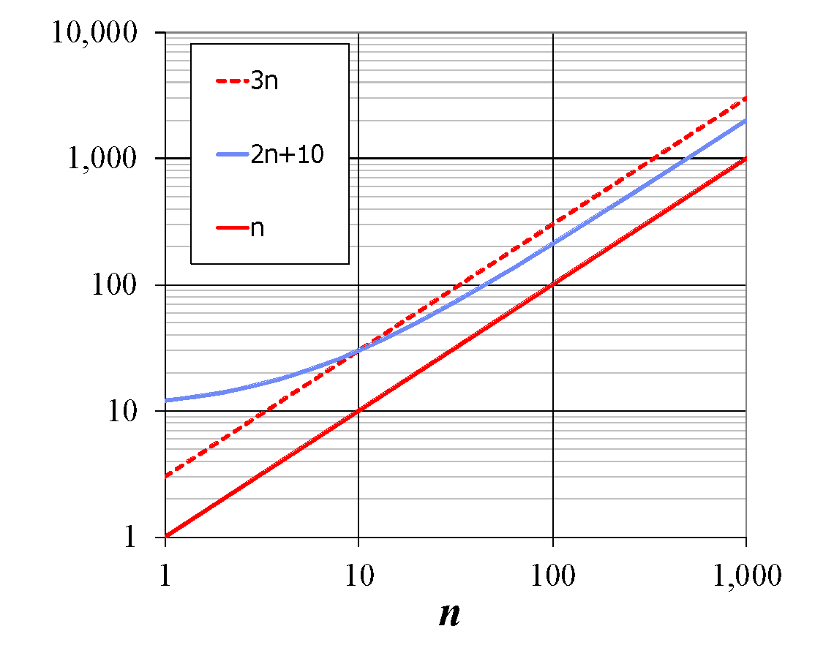
Run time complexity analysis
The run time complexity of three algorithms:
3n
2n+ 10
n
Analyses:
All functions increase linearly with the size of input
Disregard constant factors from the run time complexity analysis

Slide 16
Run time complexity analysis
The run time complexity of two algorithms:
n² + 5
n² + 2n
Analyses:
Two functions increase quadratic with the input size
Disregard lower-order terms
64
56
48
40
32
24
16
8
0.8
1.6
2.4
3.2
4.0
4.8
5.6
6.4
7.2

Slide 17
Big O notation
Given two functions f(n) and g(n) where n>=0, we denote:
f(n) = O(g(n))
If there exist two positive numbers c and n₀ such that:
f(n) <= c*g(n) when n >= n₀
c * g(n)
f(n)
n₀
n

Slide 18
Big-Oh Example
c * g(n)
Examples:
n + 9 = O(n)
2n + 1 = O(n)
n² + 7 = O(n²)
n² + 2n + 1 = O(n²)
f(n)
n₀
n

Slide 19
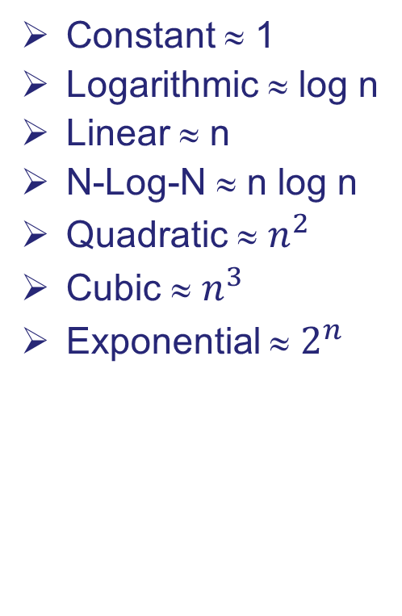
Seven Important Functions
n!
4096
2048
1024
512
2^{n}
256
128
64
n²
32
16
n log n
8
n
4
log n
2
1
1
3
4
5
6
7

Slide 20
Exercise 3
n + 1 = O(? )
9 = O (?)
2n + 5 = (?)
n² + 5n - 20 = O(?)
2n³ + 5n² + 20n – 100 = O(?)

Slide 21
Asymptotic Algorithm Analysis
The asymptotic analysis of an algorithm determines the running time in big-Oh notation
To perform the asymptotic analysis:
We find the worst-case number of primitive operations executed as a function of the input size
We express this function with big-Oh notation
Example:
We determine that algorithm arrayMax executes at most 7n − 3 primitive operations
We say that algorithm arrayMax “runs in O(n) time”
Since constant factors and lower-order terms are eventually dropped anyhow, we can disregard them when analyzing the run time complexity

Slide 22
Big-Oh Rules
If is f(n) a polynomial of degree d, then f(n) is O(n^{d}), i.e.,
Drop lower-order terms
Drop constant factors
Use the smallest possible class of functions
Say “2n is O(n)” instead of “2n is O(n²)”
Use the simplest expression of the class
Say “3n + 5 is O(n)” instead of “3n + 5 is O(3n)”
O( f(n) ) + O( g(n) ) = O( f(n) + g(n) )
O( f(n) ) × O( g(n) ) = O( f(n) × g(n) )

Slide 23
Algorithm analysis
Assignment operation
X = expression
The run time of assignment operation is the run time of expression
if-then operation
if (condition) → T₀(n)
Task 1 → T₁(n)
else
Task 2 → T₂(n)
Complexity: T₀(n) + max (T₁(n), T₂(n))

Slide 24
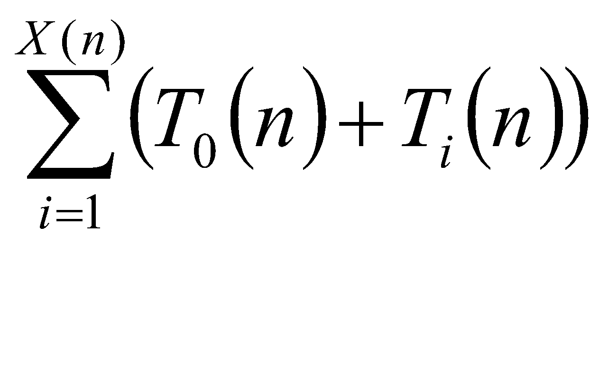
Run time of loops
for, while, do-while
X(n): # iterations
T₀(n): run time of loop condition
T_{i}(n): run time of iteration i

Slide 25
Example
Create a matrix of size n.
(1) for (i = 0 ; i < n ; i++)
(2) for (j = 0 ; j < n ; j++)
(3) A[i][j] = 0
(4) for (i = 0 ; i < n ; i++)
(5) A[i][i] = 1
Complexity:
T3 = O(1)
T12 = O(n²)
T123 = O(n²) x O(1) = O(n²)
T5 = O(1)
T4 = O(n)
T45 = O(n) x O(1) = O(n)
T12345 = T123 + T45 = O(n²) + O(n) = O(n² + n) = O(n²)

Slide 26
Exercise 4
Create a matrix of size n.
(1) for (i = 0 ; i < n ; i++)
for (j = 0 ; j < n ; j++)
if (i == j)
A[i][j] = 1;
else
A[i][j] = 0;
Complexity:

Slide 27
Exercise 5
sum = 0;
for ( i = 0; i < n; i + +)
for ( j = i + 1; j < = n; j + +)
for ( k = 1; k < 10; k + +)
sum = sum + i * j * k ;
Complexity:

Slide 28
Exercise 6
sum = 0;
for ( i = 0; i < n; i + +)
for ( j = i + 1; j < = n; j + +)
for ( k = 1; k < m; k + +) {
x = 2*y;
sum = sum + i * j * k
}
Complexity:

Slide 29
Exercise 7
for (i = 0; i < n; i ++)
for (j = 0; j < m; j ++) {
int x = 0;
4) for (k = 0; k < n; k ++)
5) x = x + k;
6) for (k = 0; k < m; k++)
7) x = x +k;
}

Slide 30
Exercise 8
Write the pseudo codes and calculate the complexity of following functions on an array:
element (p) : return the element at position p
insert (p, x): insert x into position p, elements from p are moved backward one position
delete (p): delete the element at position p, elements after p are moved forward one position.

Slide 31
Exercise 9
Write the pseudo codes and calculate the complexity of following functions on a singly linked list:
element (head, p) : return element at position p.
insert (head, p, x): insert element x into position p.
delete (head, p): delete element at position p.

